Slide 1

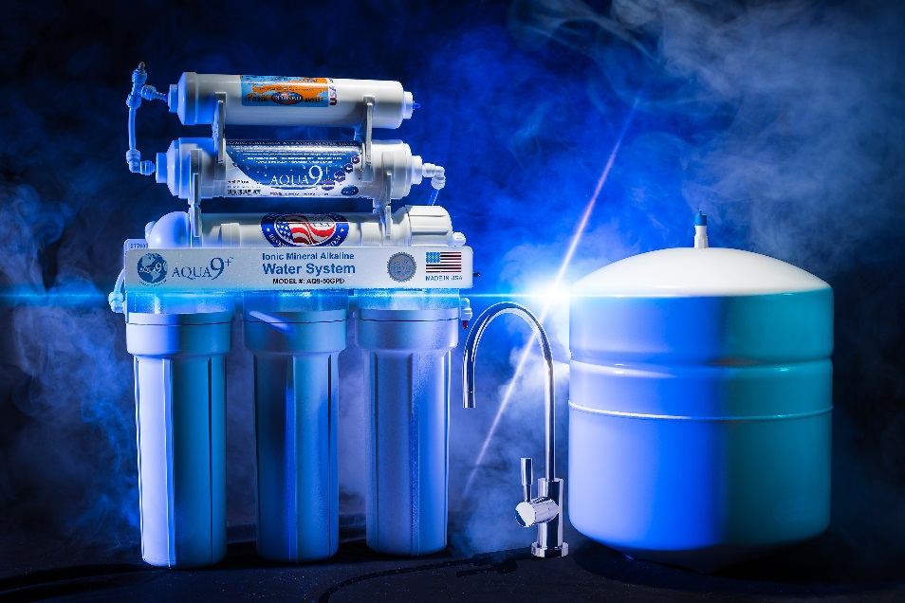
Aqua 9+ Beverage Co.
Product Presentation
Rapha Beverage, Inc.
dba Aqua 9+ Beverage Co.
7426 Orangethorpe Ave.
Buena Park, CA 90621
Toll-free: 888-648-5161 Direct: 310-720-7284
info@aquanineplus.com www.aquanineplus.com

Slide 2

Company Summary
Incorporated in January of 2007 as a small, minority-owned business, Aqua 9+ Beverage Co. has grown rapidly to include multiple products for both the domestic and international markets.
Aqua 9+ Beverage Co. is constantly researching, designing, and developing new ways to improve alkaline drinking water through its own proprietary and technological advances. This is evident with its development of the bio-available alkaline infusing system.
Aqua 9+ Beverage Co. currently produces and manufactures alkaline bottled drinking water, self-serve alkaline water-vending kiosks, alkaline drinking water home systems, and commercial alkaline water stores.

Slide 3
General Market Influences
Vast and Rapidly Expanding Global Marketplace for Alkaline Drinking Water
In recent years, we have experienced explosive growth in the alkaline drinking water industry. Alkaline drinking water products are gaining a lot of attention, but they are still in the early stages of the drinking water market. However, we expect rapid growth for the next 5-10 years.
In the past decade, we have seen a change in our society towards a healthier lifestyle. Diet and exercise are major contributors to this change. That said, we are seeing a shift in the market towards healthier drinking water consumption. In the years ahead, this shift will only gain momentum as more people become increasingly educated about the importance of a healthier diet and lifestyle.
Customer Appeal
AQUA 9+ is quickly achieving regional and national appeal in all demographic age groups. AQUA 9+ has especially strong appeal with those who are pursuing a healthy and active lifestyle.

Slide 4
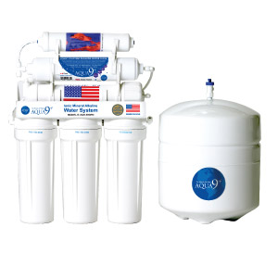
AQUA 9+ Home System
The AQUA 9+ Home System is one of the world’s first and only
Natural Ionic Mineral Alkaline Water Systems.
Unlike traditional water ionizers currently on the market, the AQUA 9+ Home System produces purified ionic mineral alkaline water, naturally, without the use of electricity. Our FDA-approved 7-step filtration process ensures the water is purified and safe from toxic impurities and heavy metals before going through our patented restructuring process. Our AQUA 9+ Home System’s bio-available alkaline infuser restructures the acidic purified water by adding essential ionic minerals (ionic calcium, ionic potassium, & ionic magnesium), which results in one of the world’s only all-natural ionic mineral alkaline drinking water, with a stable and consistent pH of 9 to 10. You get the best alkaline drinking water, right at your finger tips, 365 days a year, and at only a fraction of the cost.
Model: AQUA 9+ Home System
Size (inches): 13.7 (W) X 4.5 (D) X 19.7 (H)
Capacity: 50 gallons per day

Slide 5
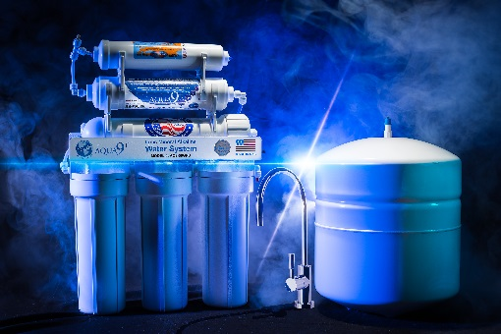
AQUA 9+ Home System FDA-approved 7-stage Process
Source
Water
Pre-carbon Filter #1
Pre-carbon Filter #2
Sediment Filter
Stage 1
Stage 2
Stage 3
Storage Tank
Proprietary Bio-Available Alkaline Infuser
RO Membrane
Stage 6
Stage 5
Stage 4
Post-carbon Filter
Stage 7
Stage 8

Slide 6
AQUA 9+ Home System FDA-approved 7-stage Process
(Stages 1-4)
Stage 1: Sediment Filter, consisting of a 5 micron polypropylene sediment-free filter, which extracts materials and impurities, such as, sand, dirt, rust (from the water pipes), insects, asbestos fiber, and all particles down to 5 micron in size.
Stage 2: Pre-Carbon Filter #1, consisting of a high quality carbon block, which absorbs all kinds of polluted materials; as well as, it removes chlorine and heavy metal by-products, such as, chloramines, THM, and TCE.
Stage 3: Pre-Carbon Filter #2, consisting of another carbon block, which removes any remaining odor as a result of the chlorine and other impurities. This pre-carbon filter is used in order to maintain absolute purity of the water prior to the water filtering through the RO membrane (Stage 4).
Stage 4: RO Membrane, is a U.S. made Thin Film Composite (TFC) Reverse Osmosis (RO) membrane, which rejects a wide spectrum of impurities, including Total Dissolved Solids (TDS), various kinds of harmful chemical substances, such as, bacteria, viruses, cancerous heavy metal phenols, pesticides, synthetic detergents, dyes, industrial wastes, asbestos, radioactive contaminated materials, etc., down to 0.0001 micron. The product water is sent to a storage tank, while the reject water is flushed down the drain.

Slide 7
AQUA 9+ Home System FDA-approved 7-stage Process
(Stages 5-7)
Stage 5: Proprietary Bio-available Alkaline Infuser, changes the acidic RO water to alkaline water by the infusion of all-natural, positively-charged calcium, magnesium, and potassium, ions into the water. These ionic minerals are added when the RO water flows over specially designed bio-available pearls, which are housed in this infuser. The ionic minerals are embedded inside the pearls through a proprietary process; and when the RO water flows over these pearls, the ionic minerals are infused into the RO water, thereby, making the water alkaline.
Stage 6: Water Storage Tank, consists of a food-grade water-storage tank, which stores the natural ionic-mineral alkaline drinking water in a sterilized environment.
Stage 7: Post-carbon Filter, consists of an in-line Granular Activated Carbon (GAC) filter, which is used to remove dissolved gases, bad taste, and odor from the product water.
Stage 8: Point-of-Use –
“ENJOY THE SMOOTH AND RICH TASTE OF AQUA 9+ ALKALINE DRINKING WATER!”

Slide 8
Anecdotal Testimonials
I’ve been on blood pressure medication for the past 3 years. Luckily, I was recently introduced to AQUA 9+ alkaline water. Over the past month, I’ve noticed my blood pressure getting lower – currently 115/70, was 150/95. My doctor was amazed and reduced my medication to ¼ dosage. After about 2½ months, goal achieved!!! I returned to the doctor and he told me to stop taking the blood pressure medication. No need!! My current blood pressure averages 115/75. This is the #1 alkaline water! Everyone needs it!!
- Hank W.
After drinking AQUA 9+ alkaline water for 3 months, I experienced weight loss, improved eyesight, and relief from digestive problems. The water also dramatically improved my appetite control and was a stepping stone to a new way of healthy food choices. I am a living testimony that this water has many benefits. I have recommended others who have also testified of the benefits. I, therefore, strongly recommend that anyone who reads this testimonial should try the water for 3 months and see if you’re not amazed.
- Edward F.
I had high cholesterol and my skin had pigment problems. After I started drinking the AQUA 9+ alkaline water, my blood test showed regular or below levels of cholesterol, and I also get compliments on my clear skin. I love ionic mineral alkaline water, and you should too!
- Debbie S.

Slide 9
AQUA 9+ Home System Summary and
Special Pricing
SUMMARY:
AQUA 9+’s home system is one of the world’s first and only all-natural ionic mineral alkaline drinking water home systems.
AQUA 9+’s home system utilizes a proprietary bio-available alkaline infusing technology.
Unlike other home systems on the market, AQUA 9+’s home system dispenses smooth and rich tasting micro-clustered alkaline drinking water, which provides the body with maximum absorption, circulation, and hydration.
AQUA 9+’s home system has the most consistent and stable pH of any home system on the market, with a pH ranging from 9 to 10.
PRICING:
Suggested Retail: $999.00
Special Price: $499.00 (FOB Buena Park, CA, USA)

